Slide 1
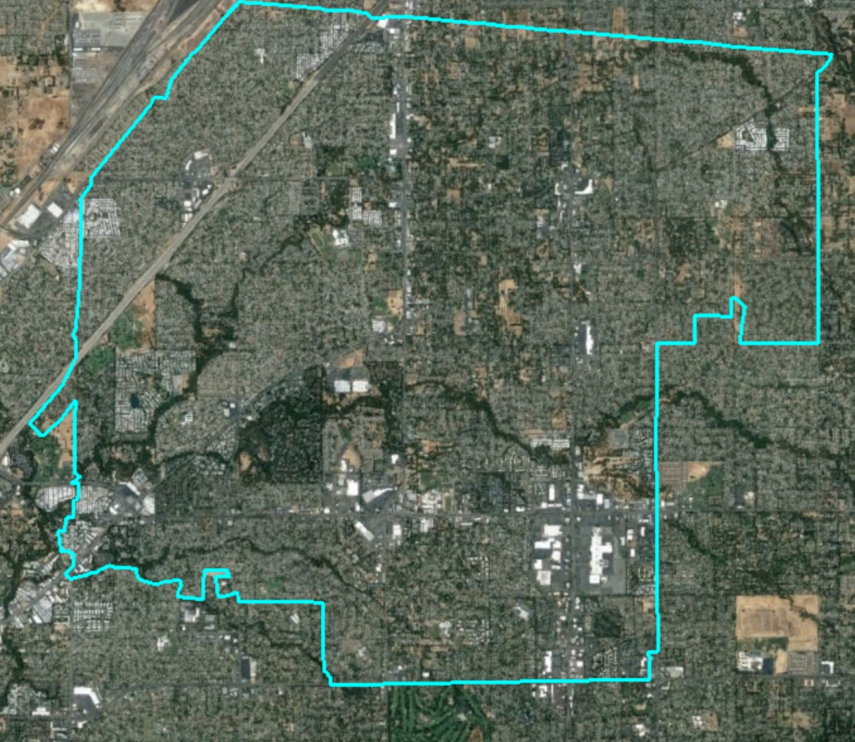
Citrus Heights
Draft Maps
Shalice Tilton, Sr. Consultant

Slide 2
Districting Process
Step | Description
Two Initial Hearings Feb. 28 & March 14 | Held prior to release of draft maps. Education and to solicit input on the communities in the District.
Release draft maps | Maps must be posted no later than May 16.
Two Hearings on Draft Maps May 23 and June 13 | Two meetings to discuss and revise the draft maps and to discuss the election sequencing. Introduce ordinance after 2nd hearing.
2nd Reading of Ordinance June 27 | Typically a formality after the vote to introduce the ordinance.
2020 | First by-district elections
2021 | Map adjusted using 2020 Census data
2022 | Remaining districts hold first by-district elections

Slide 3
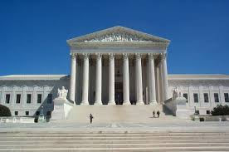
Districting Rules and Goals
Federal Laws
Traditional Redistricting Principles
Equal population
Federal Voting Rights Act
No racial gerrymandering
Communities of interest
Compact
Contiguous
Visible boundaries (natural & artificial)
Respect voters’ choices / continuity in office
Planned future growth

Slide 4
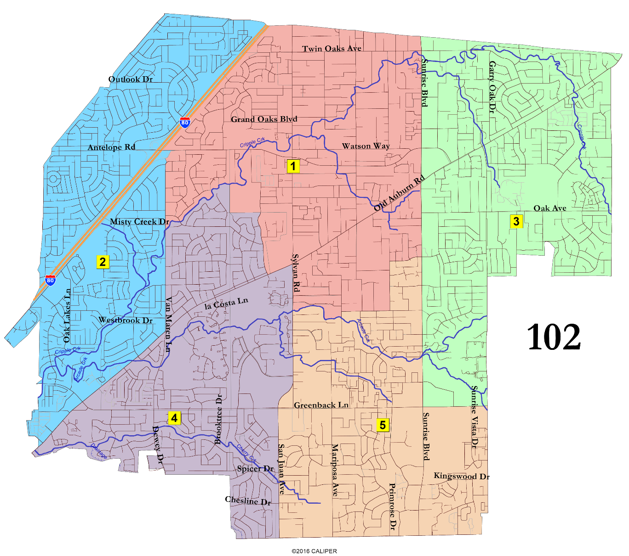
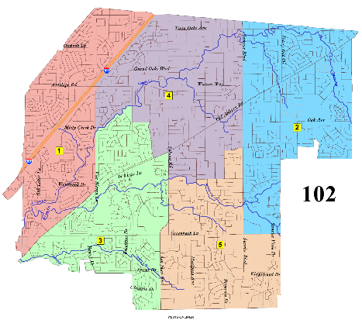
Draft Map 102 Focus Map
Visit the website for map detail
Interactive Review Map
Only Map 102 has a pairing (Daniels and Slowey).
The others have no pairings.
Renumbered
(Renumbering changes only map colors and district numbers)
Proposed Election Sequence for
Map 102 Renumbered:
2020: 1 (Slowey) and 3 (Daniels)
2022: 2 (Bruins), 4 (Miller), and 5 (Middleton)

Slide 5
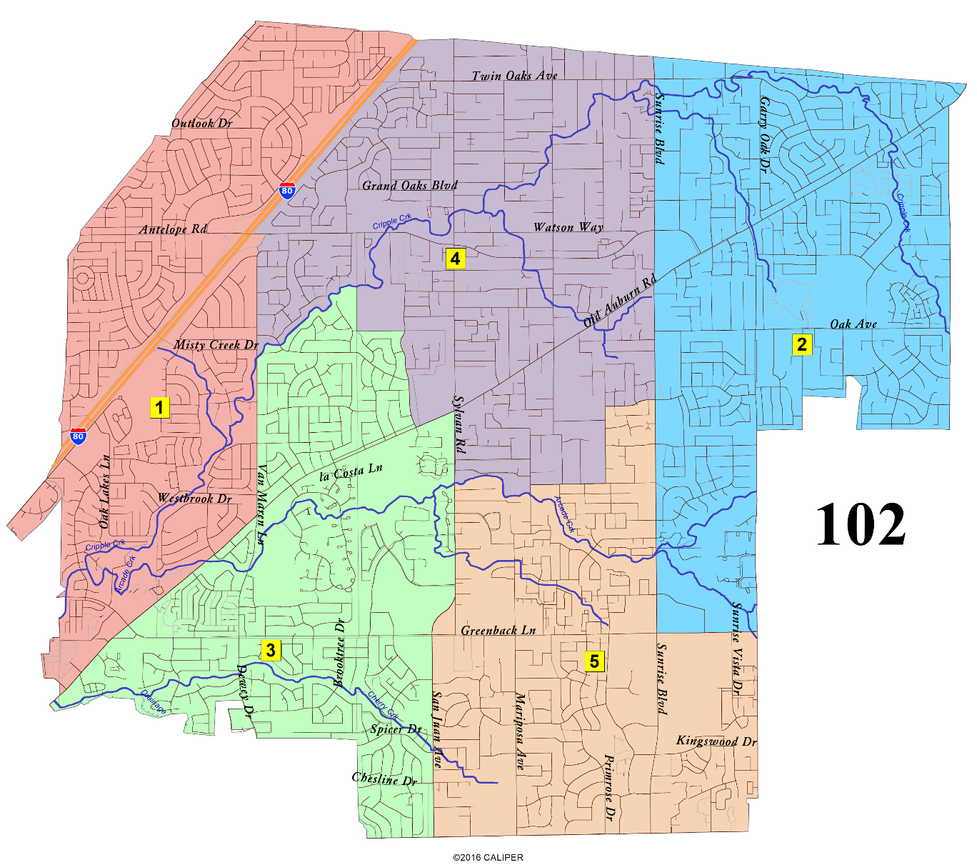
Draft Map 102 Renumbered Focus Map
Visit the website for map detail
Interactive Review Map
Only Map 102 has a pairing (Daniels and Slowey).
The others have no pairings.
Renumbered
Proposed Election Sequence for
Map 102 Renumbered:
2020: 1 (Slowey) and 3 (Daniels)
2022: 2 (Bruins), 4 (Miller), and 5 (Middleton)

Slide 6
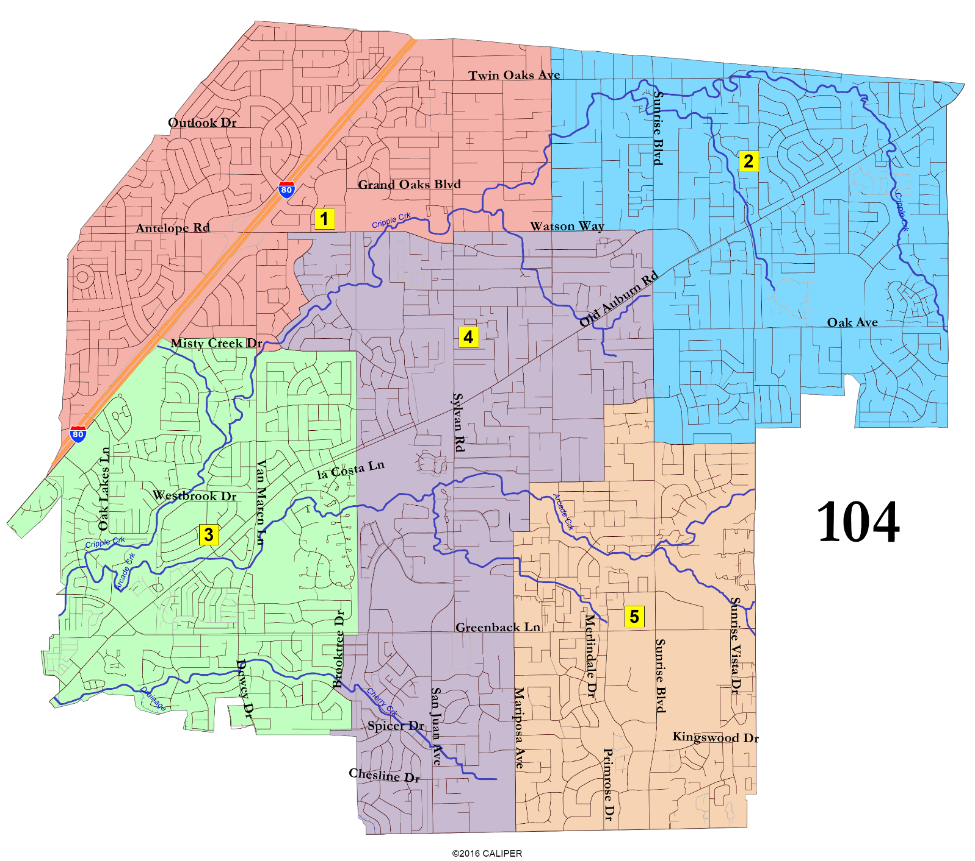
Draft Map 104 Focus Map
Visit the website for map detail
Interactive Review Map
Proposed Election Sequence for
Map 104:
2020: 1 (Slowey) and 3 (Daniels)
2022: 2 (Bruins), 4 (Miller), and 5 (Middleton)

Slide 7
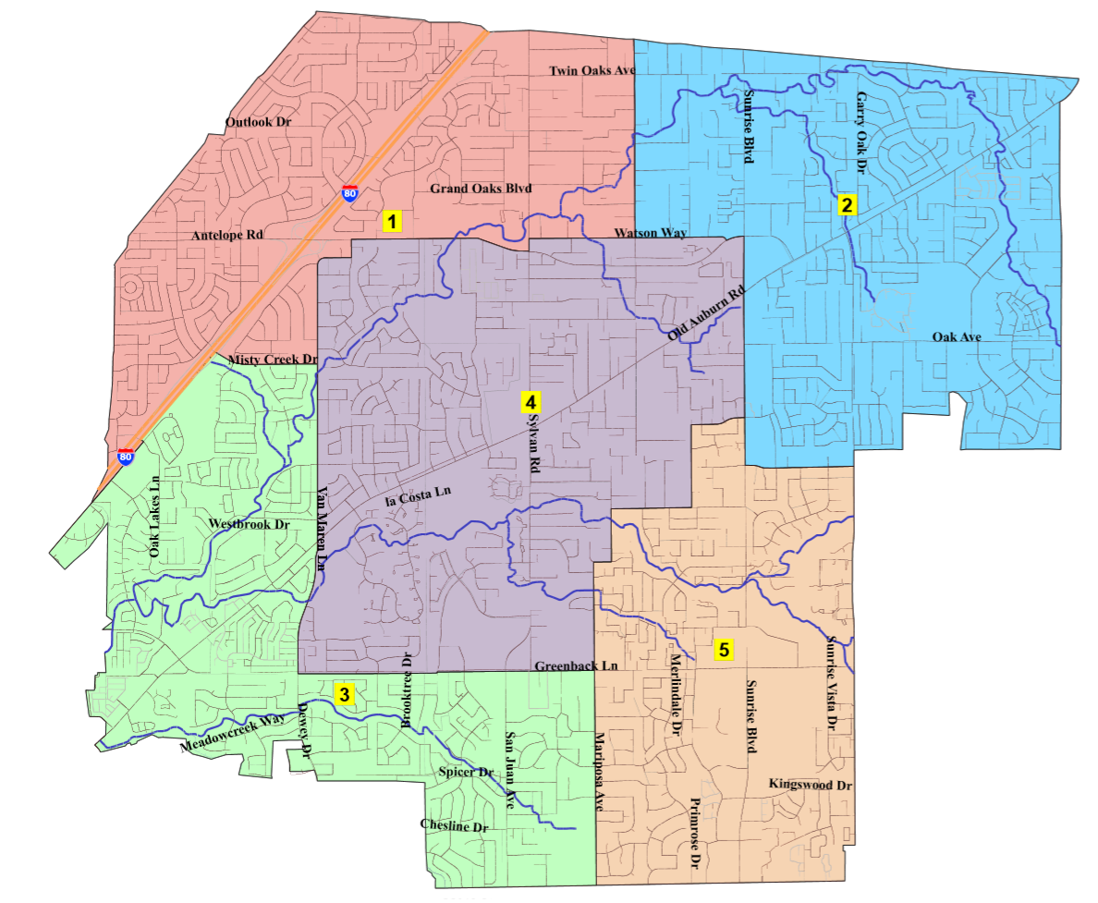
Draft Map 104b Focus Map
Visit the website for map detail
Interactive Review Map
104b
Proposed Election Sequence for
Map 104b:
2020: 1 (Slowey) and 3 (Daniels)
2022: 2 (Bruins), 4 (Miller), and 5 (Middleton)

Slide 8
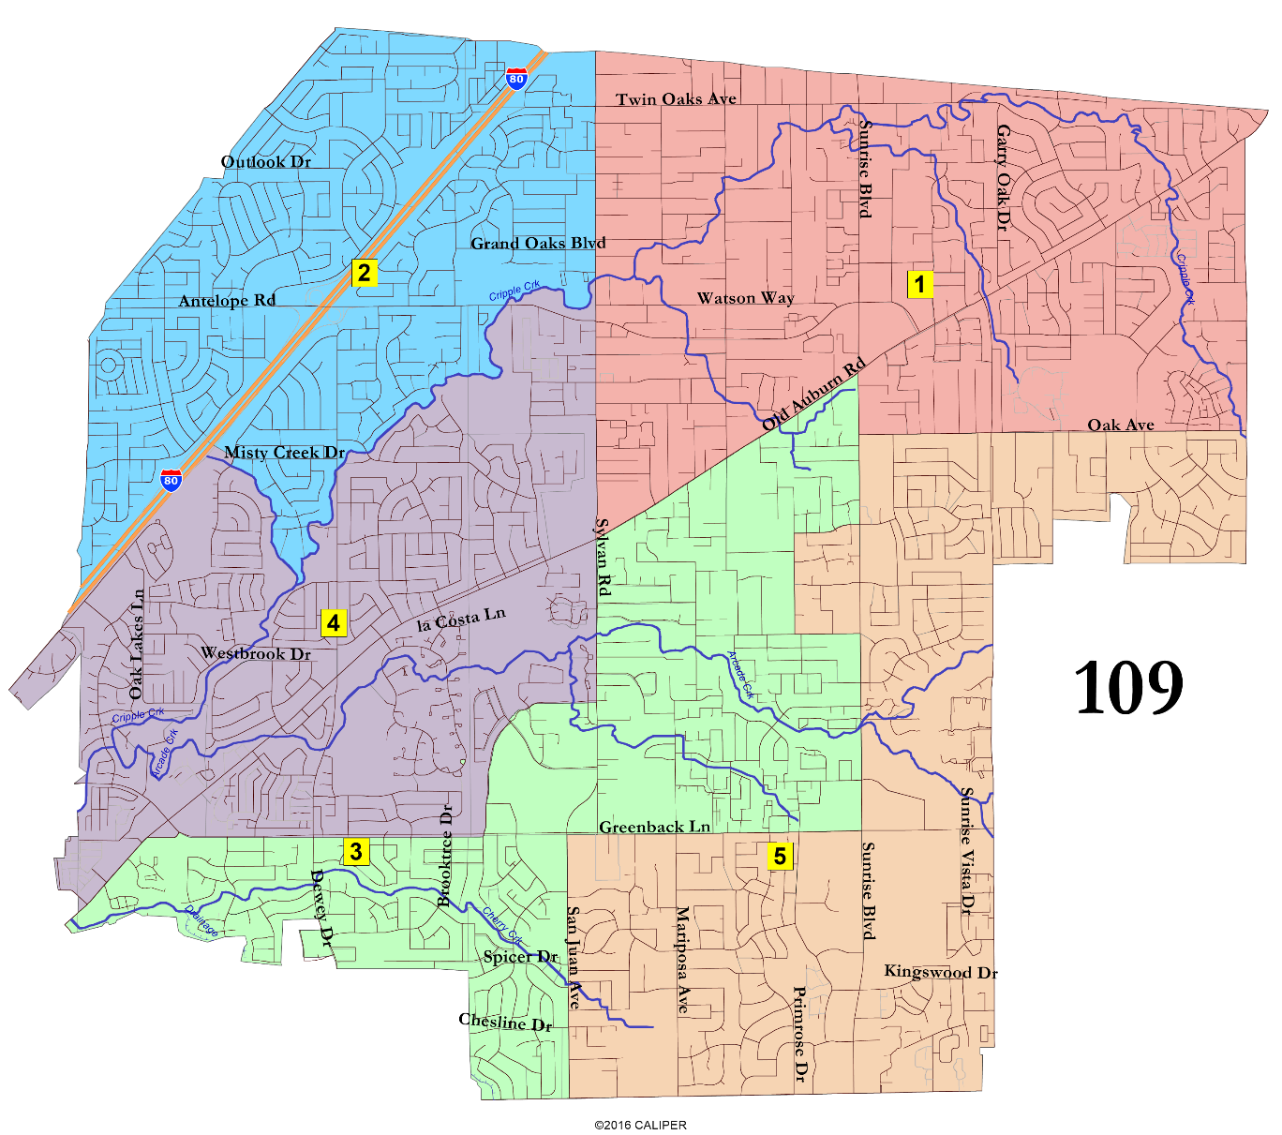
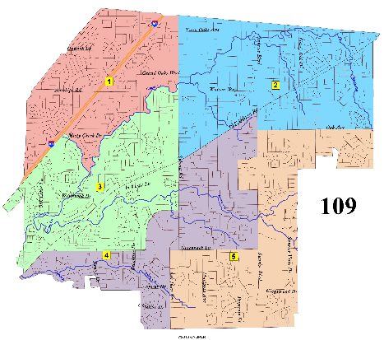
Draft Map 109 Focus Map
Visit the website for map detail
Interactive Review Map
Renumbered
(Renumbering changes only map colors and district numbers)
Proposed Election Sequence for
Map 109 Renumbered:
2020: 1 (Slowey) and 3 (Daniels)
2022: 2 (Bruins), 4 (Miller), and 5 (Middleton)

Slide 9

Draft Map 109 Renumbered Focus Map
Visit the website for map detail
Interactive Review Map
Renumbered
Proposed Election Sequence for
Map 109 Renumbered:
2020: 1 (Slowey) and 3 (Daniels)
2022: 2 (Bruins), 4 (Miller), and 5 (Middleton)

Slide 10


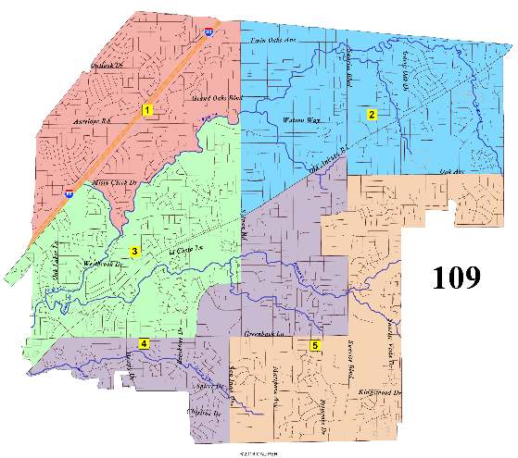
Renumbered
104b
Renumbered

Slide 11

Suggested Actions
Hold public hearing on draft maps
Discuss current draft maps
Select final map and determine election sequence
Introduce ordinance after the public hearing.

